Slide 1
The Battle of Neighborhoods for Grocery Store in Vancouver, Canada
Sonal Tarve
Jan, 2021

Slide 2
Introduction /Business Problem
Vancouver is highly populated city with high real estate prices. Opening any type of commercial establishment need to be analyzed in detail and carefully to get the maximum Return on Investment (ROI).
The purpose of this project is to find a safe and secure location for stakeholders for opening of commercial establishments in Grocery Store in Vancouver City, Canada.
The first task would be to choose the safest borough by analyzing crime data for opening a grocery store.
The second task is short listing a neighborhood, where grocery stores are not amongst the most common venues, and yet as close to many other types of venue to attract shoppers.

Slide 3
Data Involved
Real world dataset from Kaggle for Vancouver Crimes of 2018.
Wikipedia page to get borough information to map the existing info about the neighborhoods.
Use of OpenCage Geocoder to find the safest borough and explore its neighborhood along with their crime data and the respective neighborhood's co-ordinates by plotting it on maps using Folium and perform exploratory data analysis.
Use of Four Square API to fetch data to explore the neighborhood venues and to apply machine learning algorithm to cluster the neighborhoods and present the findings by plotting it on maps using Folium.

Slide 4
Analytic Approach
Visualize the crime reports in different Vancouver boroughs to identity the safest borough and normalize the neighborhoods of that borough.
First look for total crime count in various boroughs in Vancouver and from resulting data find the lower crimes borough and their number of neighborhoods.
Then select the most suitable borough and look for 10 most common venues in each neighborhood.
One hot Encoding to analyze each neighborhood
Then clustering the neighborhoods to create map
The last is to analyze the clusters to look for the suitable cluster neighborhood.

Slide 5
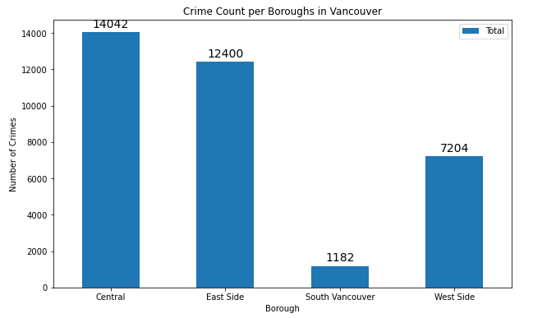
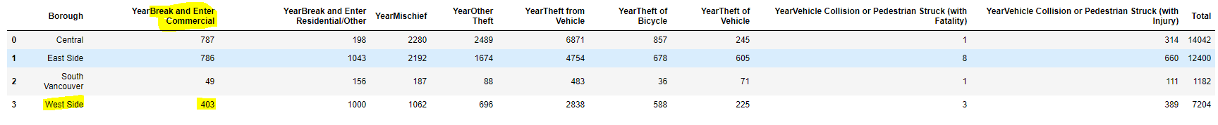
Exploratory Data Analysis
South Vancouver has very little number of neighborhoods and opening a commercial establishment would not be viable, I choose the next borough with lowest crime, which is West Side.
West side was also chosen because crime type ‘Break and enter Commercial’ is also low amongst other crimes types which makes West Side ideal destination for opening of commercial establishments

Slide 6
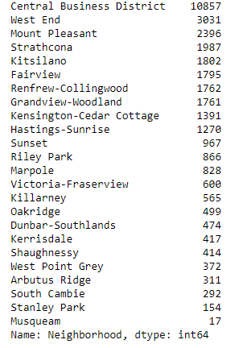
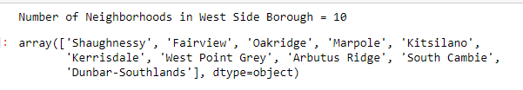
Total crime count in various neighborhoods in Vancouver and No. of Neighborhoods in West Side

Slide 7
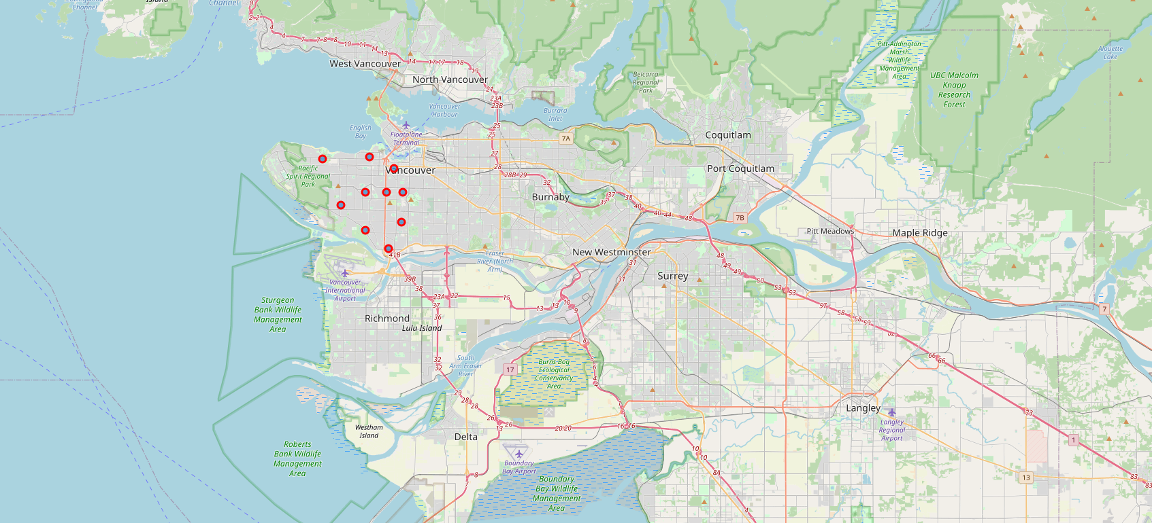
Neighborhood Map

Slide 8
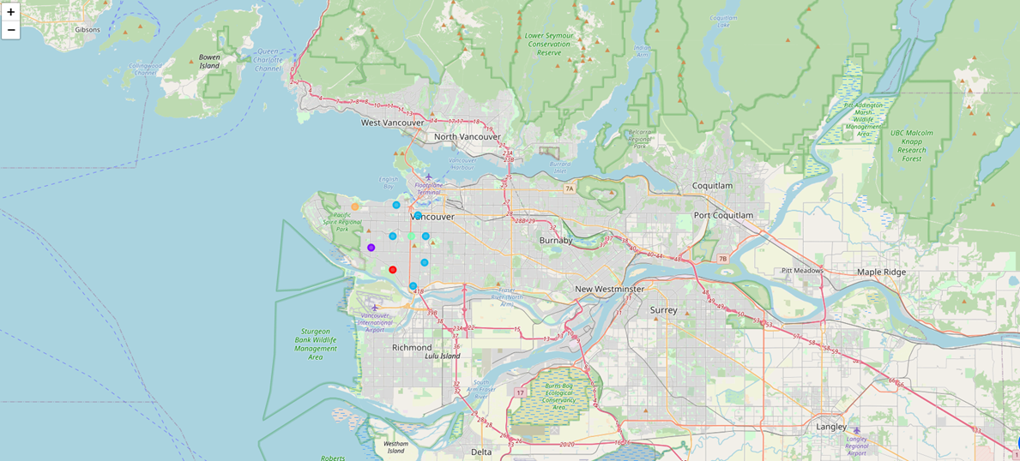
Top 10 most common venues with cluster across Neighborhoods

Slide 9
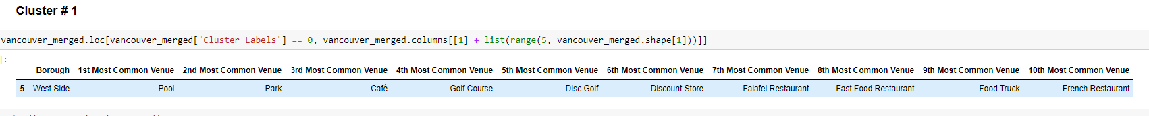
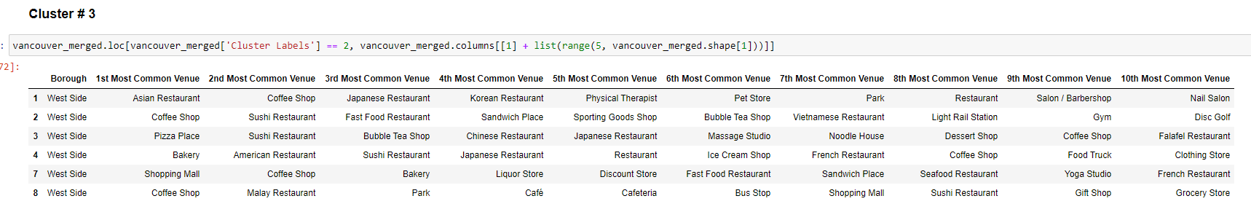
Analyzing the resulting Clusters

Slide 10
Conclusion
The goal was to help stakeholders identify one of the safest borough in Vancouver, and an appropriate neighborhood within the borough to set up a commercial establishment especially a ‘Grocery Store’.
The most safest and reasonable borough is West Side.
There are only 2 clusters with Grocery Store, Cluster 2 & 3.
The first recommendation is Cluster 3, which has only one grocery store and it is situated in the 10th most common venue ranking. At the same time, this cluster has lots of venues around to attract all types of shoppers.
The second recommendation is Cluster 1, 4 & 5. They do not have any grocery store and other good venues are around.

